Slide 1
Organisational Behaviour
Module Two:
Stress & Well-Being at Work

Slide 2
Stress and Well-Being at Work
Stress:
is a response to situations that are overwhelming in either positive or negative ways.
Stressors:
are demands on minds or bodies that are made by events or people .

Slide 3
Stress and Well-Being at Work
Cumulative stress effect occurs as stressors accumulate in a multiplicative way .
Humans have personal and physical capabilities to cope with stress and to overcome its effects.

Slide 4
Organisational Stressors
Unfair or demanding boss .
Unsupportive Co-workers.
Responsibilities that exceed authority or time
Reducing benefits

Slide 5
Organisational Stressors
Mergers and acquisitions
Frequent mandatory overtime work
Downsizing
Re-organization

Slide 6
Stress and Well-Being at Work
Environmental stress factors originate from uncertainty:
Economic
Political
Technological
It induce alarm reaction that press employees with limited stress-coping into
exhaustion .

Slide 7
Types of Stress
Distress
is a negative physical and psychological reaction to a stressor.
e.g. Demands of a job generate for the new employee fear of an annual assessment
Eustress
is a positive physical and psychological reaction to a stressor.

Slide 8
Stress and Well-Being at Work
Karoshi :
is a fatalistic Japanese expression that means to die of a heart attack or stroke at work.
Job Burnout :
is prolonged psychological withdrawal from work in employees who have come to devalue their work and to see it as a source of dissatisfaction

Slide 9
Job burnout Indicators
Difficulties concentrating on the job.
Considering the benefits of quitting.
More withdrawn at home.
Dread going to work.
More irritable with some of co-workers.
Do not feel refreshed after the weekend.

Slide 10
Stress and Well-Being at Work
General Adaptation Syndrome
is a model that shows how all living things react to stressors.
Exhaustion
is the final stage of General Adaptation Syndrome, it has effects on the body and mind created by chronic stress overload.

Slide 11
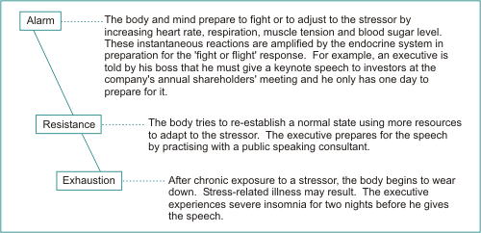
General Adaptation Syndrome

Slide 12
Stress and Well-Being at Work
Resistance
is that phase of General Adaptation Syndrome where a person uses his body and mind to cope with high stress loads.

Slide 13
Understanding Job Stress and its Components
Stress response can be either a physiological or a psychological reaction to a stressor or both.
Behavioural stress symptoms are employees' actions that denote low performance in attentiveness and lack of carefulness in work

Slide 14
Causes and Consequences of Stress
There are three categories of causes of job stress:
Environmental
Organizational
Individual
The categories of consequences of job stress are:
Physiological
Psychological
Behavioral

Slide 15
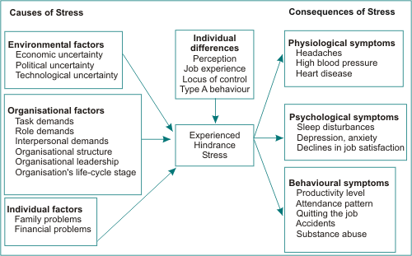
The Stress Model

Slide 16
Causes of Stress
Environmental Factors:
Economic Uncertainty
increased competition
falling demand or prices, downsizing, pay
Political Uncertainty
in countries with unstable political systems.
Technological Uncertainty
through technological breakthrough

Slide 17
Causes of Stress
Individual Stress Factors :
It represent personal life circumstances and relationships.
Personal Lifestyle Factors:
Family problems
Financial problems

Slide 18
Causes of Stress
Organisational Factors:
Task demands:
Autonomy
Noise levels
The speed of work flow
Temperature
Humidity levels

Slide 19
Causes of Stress
Role Demands :
Conflicts between the employee’s personal values and supervisory and organisational values.
Employees experience role overload in downsized organizations
Role ambiguity is a source of job stress because of the poor job understanding

Slide 20
Causes of Stress
Interpersonal Demands:
The pressures created by groups and the employee’s coworkers.
Stress inducing for employees who are affiliation oriented
Organisational Structure:
Extensive rules, high centralisation and low levels of employee participation in decisions

Slide 21
Causes of Stress
Organisational Leadership:
A short run viewpoint
Higher output with few resources
Tight financial controls.
Organisation's Life-Cycle Stage:
Company survival is uncertain in both the establishment and decline phases.

Slide 22
Consequences of Stress
Physiological Symptoms
Are physical changes accompany stressors.
Back pain, migraine headaches, insomnia, heart disease, hypertension, diabetes
are linked to extended exposure to chronic stressors.
Psychological Symptoms
as anxiety and depression and may appear before chronic physical problems or disease.

Slide 23
Psychological Symptoms,
These problems result in
Low employee performance
Declines in self-esteem
Resentment of supervision
Inability to concentrate
Trouble in making decisions.

Slide 24
Stress Symptoms
Behavioural Symptoms
Productivity level
Attendance pattern
Quitting the job
Accidents
Substance abuse

Slide 25
Individual Differences
Individual Differences
Locus of Control
Perception
Job Experience
Type A Behaviour

Slide 26
Locus of Control
is a pattern of beliefs about the connection between behaviour and its consequences.
Internalisers believe that they are in control of their lives.
Externalisers believe that often fate intrudes to create outcomes in life that are not related to their behaviour.
Internalisers perceive their jobs to be less stressful than do externalisers.

Slide 27
Type A Behaviour
Type A Behaviour
is defined as an action emotion complex that can be observed in persons who are aggressively involved in chronic struggle to achieve more in less time, against the opposing efforts of other persons.

Slide 28
Type A Behaviour
Working long hours under the conditions of deadline pressures & chronic overload.
Take work home and are unable to relax at weekends or on vacations.
Compete with themselves & with others by setting high standard for performance
4- Impatient & easily irritated .

Slide 29
Profiles of Type A & Type B Behavioral Patterns
Type A
Active and moving
Walks, talks & eat rapidly
Does two things at once
Can’t cope with leisure
Obsessed with numbers & performance measures
Highly competitive
Experiences constant time pressure
Type B
Relaxes without guilt
Not concerned about time
Patient
Does not brag
Plays for fun, not to win
Has no pressing deadlines
Never rushed
.
Notes:
Type A is now strongly correlated with forms of heart disease.

Slide 30
Individual Differences
Perception :
we react less to the reality of the situation than to how we interpret and perceive the situation.
Reality matters less than our perception of it as a cause of stress.
Apprehension about an upcoming job event is usually much worse than the event itself.

Slide 31
Individual Differences
Job Experience:
is a powerful stress reducer once it is acquired.
For a new employee in a new job, the absence of job experience is a powerful stressor.
Accumulated job experience means the acquisition of job coping skills by employees.

Slide 32
Stress & Performance
Behavioural Symptoms
Changes in performance
Absenteeism
Job hopping
Use of drugs
Withdrawal behaviour.

Slide 33
Stress & Performance
Low to moderate stress levels stimulate the employee and increase his tendency to act to reduce stress levels by performing effectively.
High levels of stressors cause performance to deteriorate .

Slide 34
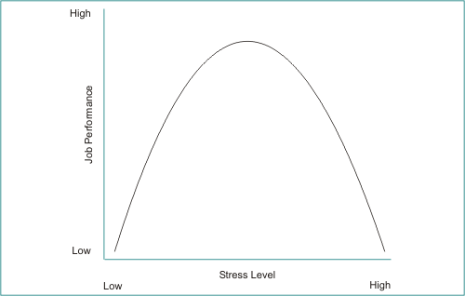
The Stress–Job Performance Relationship
If stress levels on the job are moderate, but long lasting, performance will also deteriorate due to the
problem of cumulative stress.
Notes:
The stress–job performance relationship

Slide 35
Individual Techniques For Stress Management
Employees are responsible for coping with job stress and for maintaining healthy lifestyle.
Techniques to overcome stress :
Exercise requires more blood flow to muscles
Walking
Riding bicycles
Aerobics
Jogging
Swimming
Tennis

Slide 36
Individual Techniques For Stress Management
This causes exercising employee to be more distracted from work problems and stressors
Relaxation.
Through prayer & meditation.
The relaxation response reverses the stress response in the human mind body system.
It reduces their heart rates, blood pressure and other physiological indicators of stress.

Slide 37
Individual Techniques For Stress Management
Diet.
Foods with high sugar content stimulate or prolong the stress response and high cholesterol foods adversely affect blood chemistry.
Professional help.
Clinical counseling or Career counseling,
Physical therapy
Medical treatment

Slide 38
Individual Techniques For Stress Management
Opening Up.
A healthy response to these moments or periods of personal crisis is to confide in others.
Self disclosure can induce lower stress
Honest entries on a regular basis in a diary
Confessing to others

Slide 39
Organisational Programmes of Wellness & Stress Management
Reward performance and productivity.
Live by your values and encourage others to live by theirs.
Build respect based on trust .

Slide 40
Corporate Wellness Plans
Some companies use tests for high blood pressure and cholesterol to identify high risk employees.
Using a variety of direct and indirect incentives,
like discounts on health insurance premiums.

Slide 41
Downsizing Reasons
Contract employees
Outsourcing of functions
Improvements in technology
Free trade as an alleged cause of job layoffs
Shifts of production to overseas locations

Slide 42
Downsizing and Stress
1. Competition.
2. Mergers.
3. Government Spending
4. Small is Beautiful Concept

Slide 43
Small is Beautiful Principles
Share credit
Ask for forgiveness instead for permission
Come to work each day willing to be fired
Follow your gut about people
Ask for advice before asking for resources
Be realistic about how to achieve your goals

Slide 44
Job Security Vs. Employment Security
Employment security is possessed by individuals who have wide experience, a variety of skills and knowledge in many industries and functional areas.

Slide 45
Downsizing
Is downsizing always the right solution ?

